Slide 1
SWE 4803
Lec - 5

Slide 2
Quiz
A project aims to develop a cloud-based financial management application for small businesses. The project charter, created by the project manager on behalf of the project sponsor, has been approved. Which of the following processes should be performed next?
  Develop Project Management Plan
  Identify Risks
  Identify Stakeholders
  Develop Project Charter

Slide 3
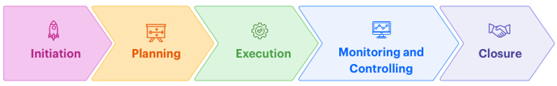
Planning Process Group
Planning Process Group
Develop Project Management Plan ⇒ Project Integration Management
Plan Scope Management ⇒ Project Scope Management
Collect Requirements ⇒ Project Scope Management
Define Scope ⇒ Project Scope Management
Create WBS ⇒ Project Scope Management
Plan Schedule Management ⇒ Project Schedule Management
Define Activities ⇒ Project Schedule Management
Sequence Activities ⇒ Project Schedule Management
Estimate Activity Durations ⇒ Project Schedule Management
Develop Schedule ⇒ Project Schedule Management
Plan Cost Management ⇒ Project Cost Management
Estimate Costs ⇒ Project Cost Management

Slide 4
Planning Process Group
Planning Process Group
Determine Budget ⇒ Project Cost Management
Plan Quality Management ⇒ Project Quality Management
Plan Resource Management ⇒ Project Resource Management
Estimate Activity Resources⇒ Project Resource Management
Plan Communications Management ⇒ Project Communication Management
Plan Risk Management ⇒ Project Risk Management
Identify Risks ⇒ Project Risk Management
Perform Qualitative Risk Analysis ⇒ Project Risk Management
Perform Quantitative Risk Analysis ⇒ Project Risk Management
Plan Risk Responses ⇒ Project Risk Management
Plan Procurement Management ⇒ Project Procurement Management
Plan Stakeholder Engagement ⇒ Project Stakeholder Management

Slide 5
1. Develop Project Management Plan
Process
Output
Develop Project management Plan
Project Management Plan

Slide 6
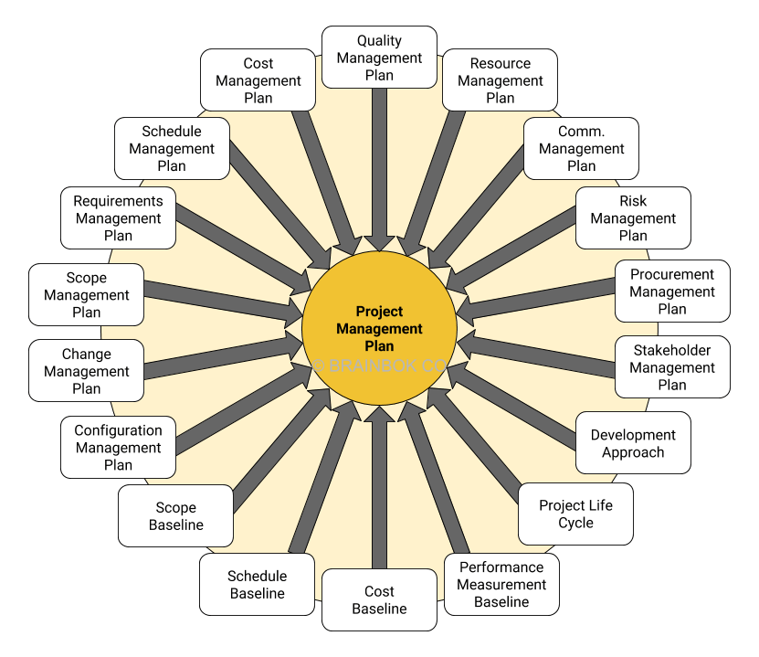
Project Management Plan
We will be back here after completing related processes

Slide 7
Plan Scope Management
Plan Scope Management is the process of creating a scope management plan that documents how the project and product scope will be defined, validated, and controlled..
Process
Output
Plan Scope Management
Scope management plan
Requirements management plan

Slide 8
Plan Scope Management
KEY CONCEPTS FOR PROJECT SCOPE MANAGEMENT
In the project context, the term “scope” can refer to:
Product scope - The features and functions that characterize a product, service, or result.
Project scope - The work performed to deliver a product, service, or result with the specified features and functions. The term “project scope” is sometimes viewed as including product scope.

Slide 9
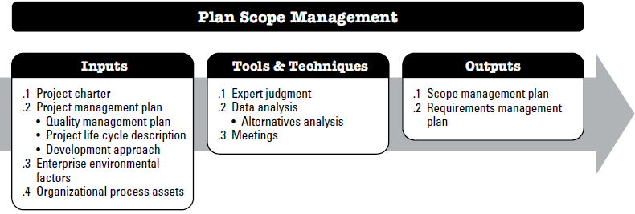
Plan Scope Management

Slide 10
Plan Scope Management
Input:
Project charter
From project charter, we get project purpose, high-level (birds eye view) project description, assumptions, constraints, and high-level requirements that the project is intended to satisfy.
Project Mgt plan
Quality management plan, Project life cycle description, Development approach
EEF & OPA
EEF - Organizations culture, infrastructure, personnel administration and marketplace condition
OPA - Policy, procedure, historical information, lesson learned

Slide 11
Plan Scope Management
Tools & Techniques:
Expert judgment
From knowledgeable and experienced parties
Data Analysis
Various ways of collecting requirements, elaborating the project and product scope, creating the product, validating the scope, and controlling the scope are evaluated.
Meetings
Attendees at these meeting my include project manager, project sponsor, selected team members etc.

Slide 12
Plan Scope Management
Output:
Scope management plan
is a component of the project management plan that describes how the scope will be defined, developed, monitored, controlled, and validated. It includes: (ddmcv)
Requirement management plan
How requirements activities will be planned, tracked, and reported; (ptr)
Process that enables the creation of the WBS from the detailed project scope statement;
Process that establishes how the scope baseline will be approved and maintained; and
Process that specifies how formal acceptance of the completed project deliverables will be obtained.
Process for preparing a project scope statement;
Configuration management activities such as: how changes will be initiated; how impacts will be analyzed; how they will be traced, tracked, and reported; as well as the authorization levels required to approve these changes;
Requirements prioritization process;
Metrics that will be used and the rationale for using them; and
Traceability structure that reflects the requirement attributes captured on the traceability matrix.

Slide 13
Collect Requirement
Collect Requirements is the process of determining, documenting, and managing (ddm) stakeholder needs and requirements to meet objectives.
Process
Output
Collect Requirements
•Requirement Documentation
•Requirement Traceability Matrix

Slide 14
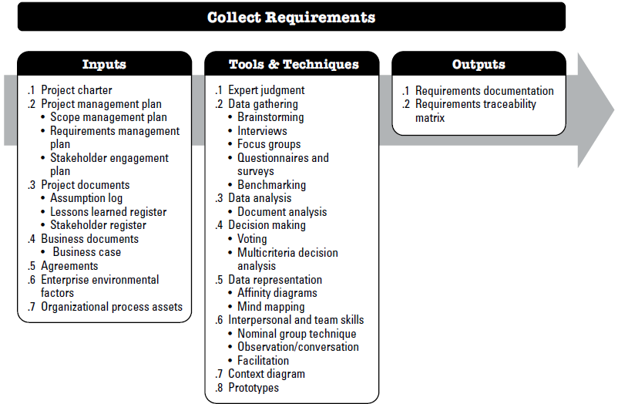
Collect Requirement

Slide 15
Collect Requirement
Input:
Project charter
The project charter documents the high-level project description and high-level requirements that will be used to develop detailed requirements.
Project Mgt plan
Scope management plan.
Project Documents
Assumption log
Lesson learned register
Stakeholder register
Requirement management plan
Stakeholder management plan

Slide 16
Collect Requirement
Input:
Business Documents
A business document that can influence the Collect Requirements process is the business case, which can describe required, desired, and optional criteria for meeting the business needs.
Agreements
Agreements can contain project and product requirements.
EEF & OPA
EEF - Organization’s culture, Infrastructure, Personnel administration, and Marketplace conditions.
OPA - Policies and procedures, and Historical information and lessons learned repository with information from previous projects.

Slide 17
Collect Requirement
Tools & Techniques: Expert judgment
Expertise should be considered from individuals or groups with specialized knowledge or training in the following topics:
  Business analysis
  Requirements elicitation
  Requirements analysis
  Requirements documentation
  Project requirements in previous similar projects
  Diagramming techniques
  Facilitation, and
  Conflict management.

Slide 18
Collect Requirement
Tools & Techniques: Data Gathering
includes:
  Brainstorming
  Interviews
  Questionnaires
  Surveys
  Benchmarking
  Focus groups

Slide 19
Collect Requirement
Tools & Techniques: Data Analysis
There are wide range of documents that may be analyzed to help elicit relevant
requirements.
  Agreements;
  Business plans;
  Business process or interface documentation;
  Business rules repositories;
  Current process flows;
  Marketing literature;
  Problem/issue logs;
  Policies and procedures;
  Regulatory documentation such as laws, codes, or ordinances, etc.;
  Requests for proposal; and
  Use cases.

Slide 20
Collect Requirement
Tools & Techniques: Decision-making
Voting
  Unanimity: 100% agreement
  Majority: 50% +
  Plurality: largest block
Autocratic Decision Making
Multicriteria decision analysis

Slide 21
Collect Requirement
Tools & Techniques: Decision-making
Multicriteria decision analysis
Define your objective
Define your criteria (non-beneficial & beneficial)
Determine the weight of each criterion
List your choices
Determine your performance values
Rate your choices
Normalize the performance values (non-beneficial & beneficial) for non-beneficial criteria, you should take the lowest value of these criteria and divide it by each performance value. For beneficial criteria, you divide each by the maximum value.
Multiply values by weight
Calculate the performance scores

Slide 22
Collect Requirement
Tools & Techniques: Decision-making
Multicriteria decision analysis
To finish the 360-degree image viewer development for your ongoing software project, you need to incorporate an image stitching library. Due to your company's lack of expertise in image stitching, you have decided to outsource the image stitching library and have gathered data on four different image stitching libraries from four different companies. Your job is to assess and select the most suitable image stitching library from four available options with proper justification by considering the criteria provided in Table below. To decide based on the given criteria, you need to consider that the Resolution Limit holds the highest weightage of 40%, while all other criteria are considered equally important. Furthermore, price is the only non-beneficial factor.
 | Criteria
 | Price | Library Size | Resolution Limit | Performance
Image Stitching Lib 1 | $2500 | 16 MB | 12 MP | Excellent (5)
Image Stitching Lib 2 | $2000 | 16 MB | 8 MP | Average (3)
Image Stitching Lib 3 | $3000 | 32 MB | 16 MP | Good (4)
Image Stitching Lib 4 | $2750 | 32 MB | 8 MP | Good (4)

Slide 23
Collect Requirement
Tools & Techniques: Decision-making: Multicriteria decision analysis
 | Criteria
 | Price | Library Size | Resolution Limit | Performance
Image Stitching Lib 1 | $2500 | 16 MB | 12 MP | Excellent (5)
Image Stitching Lib 2 | $2000 | 16 MB | 8 MP | Average (3)
Image Stitching Lib 3 | $3000 | 32 MB | 16 MP | Good (4)
Image Stitching Lib 4 | $2750 | 32 MB | 8 MP | Good (4)
Normalizing
 | Criteria
 | Price | Library Size | Resolution Limit | Performance
Image Stitching Lib 1 | (2000/2500) | 16/32 | 12 /16 | 5/5
Image Stitching Lib 2 | (2000/2000) | 16 /32 | 8 /16 | 3/5
Image Stitching Lib 3 | (2000/3000) | 32 /32 | 16 /16 | 4/5
Image Stitching Lib 4 | (2000/2750) | 32 /32 | 8 /16 | 4/5
0.76
0.62
0.8934
0.7054

Slide 24
Collect Requirement
Tools & Techniques: Decision-making: Multicriteria decision analysis
 | Criteria
 | Price | Library Size | Resolution Limit | Performance
Image Stitching Lib 1 | $2500 | 16 MB | 12 MP | Excellent (5)
Image Stitching Lib 2 | $2000 | 16 MB | 8 MP | Average (3)
Image Stitching Lib 3 | $3000 | 32 MB | 16 MP | Good (4)
Image Stitching Lib 4 | $2750 | 32 MB | 8 MP | Good (4)
Multiply by weights
 | Criteria
 | Price | Library Size | Resolution Limit | Performance
Image Stitching Lib 1 | .8*.2 | .5*.2 | .75*.4 | 1*.2
Image Stitching Lib 2 | 1*.2 | .5*.2 | .5*.4 | .6*.2
Image Stitching Lib 3 | .667*.2 | 1*.2 | 1*.4 | .8*.2
Image Stitching Lib 4 | .727*.2 | 1*.2 | .5*.4 | .8*.2
0.76
0.62
0.8934
0.7054

Slide 25
Collect Requirement
Tools & Techniques: Decision-making: Multicriteria decision analysis
 | Criteria
 | Price | Library Size | Resolution Limit | Performance
Image Stitching Lib 1 | $2500 | 16 MB | 12 MP | Excellent (5)
Image Stitching Lib 2 | $2000 | 16 MB | 8 MP | Average (3)
Image Stitching Lib 3 | $3000 | 32 MB | 16 MP | Good (4)
Image Stitching Lib 4 | $2750 | 32 MB | 8 MP | Good (4)
Multiply by weights
 | Criteria
 | Price | Library Size | Resolution Limit | Performance
Image Stitching Lib 1 | .16 | .1 | .3 | .2
Image Stitching Lib 2 | .2 | .1 | .2 | .12
Image Stitching Lib 3 | .1334 | .2 | .4 | .16
Image Stitching Lib 4 | .1454 | .2 | .2 | .16
0.76
0.62
0.8934
0.7054

Slide 26
Solve now
You are leading a project to implement a real-time sentiment analysis module for a customer service platform. To speed up development and ensure reliability, your team has decided to integrate an external Natural Language Processing (NLP) API instead of building the sentiment engine from scratch.
You have shortlisted four different NLP APIs from different vendors. Your task is to evaluate and select the most suitable NLP API using the criteria listed in the table below. The Accuracy Rate is considered the most important factor, carrying a weight of 40%, while the other criteria (Latency, API Flexibility, Documentation Quality, and Cost) are equally weighted. Cost is the only non-beneficial criterion whereas all others are beneficial.
API Option | Accuracy Rate (%) | Latency (ms) | API Flexibility (1–10) | Documentation Quality (1–10) | Cost ($/month)
API A | 91 | 280 | 8 | 7 | 450
API B | 87 | 200 | 6 | 9 | 400
API C | 93 | 320 | 7 | 8 | 550
API D | 89 | 250 | 9 | 6 | 380

Slide 27
Collect Requirement
Tools & Techniques: Data representation
Affinity diagrams. Affinity diagrams allow large numbers of ideas to be classified into groups for review and analysis.
Mind mapping. Mind mapping consolidates ideas created through individual brainstorming sessions into a single map to reflect commonality and differences in understanding and to generate new ideas.

Slide 28
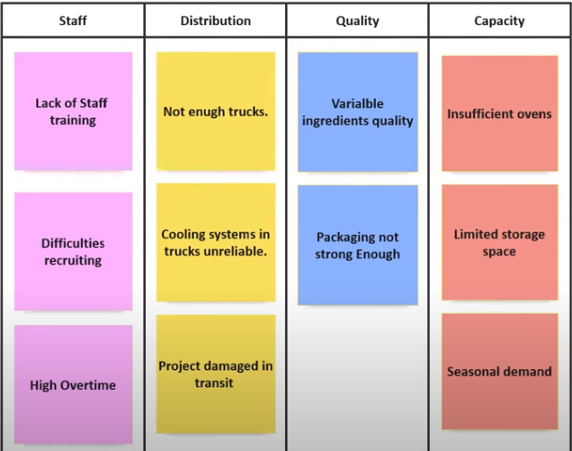
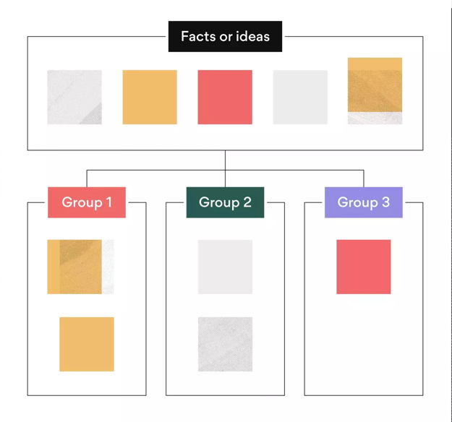
Collect Requirement
Tools & Techniques: Data representation
Challenges in Production
Affinity diagrams.

Slide 29
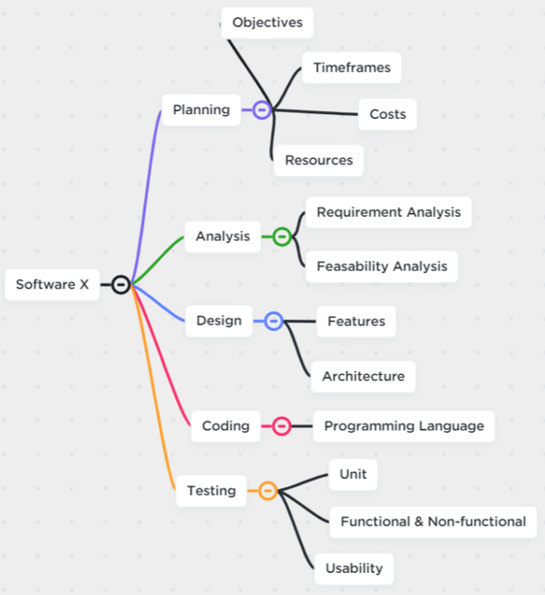
Collect Requirement
Tools & Techniques: Data representation
Mind mapping.
To build a mind map diagram, you first choose a central idea or main topic. The main topic will have branches that connect it to other linked subtopics, and you repeat the process until you have a literal map of your mind!

Slide 30
Collect Requirement
Tools & Techniques: Data representation
Mind mapping.
Prepare a mind map for Arranging a Meeting

Slide 31
Collect Requirement
Tools & Techniques: Interpersonal and Team skills
  Nominal group technique
  Observation and conversation
  facilitation

Slide 32
Collect Requirement
Tools & Techniques: Context diagram
  Example of a scope model
  Visually depict the product scope by showing business system and how people and other system interact with it.
Tools & Techniques: Prototype
  Prototyping is a method of obtaining early feedback on requirements by providing a model of the expected product before actually building it.

Slide 33
Collect Requirement
Output:
Requirement Documentation
Business requirement
Requirement traceability matrix
business need, opportunity, goal
Stakeholders’ requirements
Solution requirements
Functional & non-functional requirements
Transition and readiness requirements
Project requirement
Quality requirement
Project objectives
WBS deliverables
Product design and development
Test scenario
High level to detail level

Slide 34
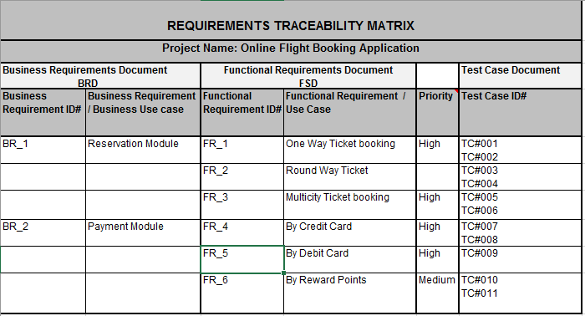

Slide 35
Define Scope
The process of developing a detailed description of the project and product
Process
Output
Define Scope
Project Scope Statement
Project Document Updates

Slide 36
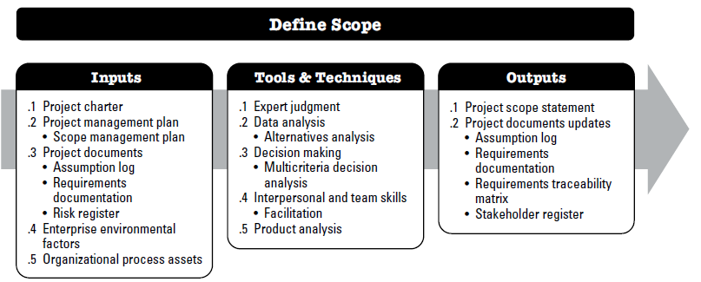
Define Scope

Slide 37
Define Scope
Tools & Techniques: Product Analysis
product analysis techniques include but are not limited to:
  Product Features and Functionality,
  Requirements analysis,
  Systems analysis,
  Lifecycle Analysis,
  Value analysis, and
  Value engineering.

Slide 38
Define Scope
Output:
Project Scope Statement
Product scope description.
Project Document Updates
Assumption log
Requirement tractability matrix
Stakeholder register
Requirement documentation
Deliverables
Acceptance criteria
Project exclusion
The project charter contains high-level information, while the project scope statement contains a detailed description of the scope components.

Slide 39
Define Scope
Acceptance criteria:
Acceptance criteria are a set of conditions or requirements that a product, feature, or user story must meet to be accepted by the user, customer, or product owner.
They answer the question: “What does “done” mean for this work?”
Purpose of Acceptance Criteria
  Define clear expectations for a feature or task
  Help developers and testers understand what to build and test
  Avoid misunderstandings
  Guide user story validation
In Agile (like Scrum), acceptance criteria are often written before development starts as part of the Definition of Done.
Example (To-Do List App)
User Story:
As a user, I want to mark a task as complete, so that I can track what I’ve finished.
Acceptance Criteria:
  User can click a checkbox to mark the task complete.
  Completed tasks appear with a strikethrough.
  Completed tasks are saved even after refreshing the page.
  A completed task can be marked as “incomplete” again.

Slide 40
Define Scope
Assumption log:
Assumption log is a document or list that records all the assumptions made during a project. These are things the team believes to be true without full proof or certainty at the time of planning or execution.
What Is an Assumption?
An assumption is something you accept as true for now, to plan or make progress, even though it might change later.
Example:
“We assume the third-party API will be available 24/7.”
“We assume the client will provide all required data by next week.”
Purpose of the Assumption Log
  Track all assumptions in one place
  Allow the team to review, monitor, and update them
  Help identify risks if assumptions turn out to be false
  Improve decision-making during uncertainty

Slide 41
Define Scope
Assumption log:
ID | Assumption | Date Logged | Owner | Status
A1 | Users will access the system only during business hours | 2025-06-17 | Project Manager | Valid
A2 | Client will approve the design within 5 working days | 2025-06-17 | Product Owner | Pending
A3 | No major changes in regulatory requirements | 2025-06-17 | Compliance Officer | To be reviewed

Slide 42
Define Scope
Assumption log:
ID | Assumption | Status | Meaning
A1 | API will be stable during development | Valid | Already tested; it’s working fine.
A2 | Client will provide data by Friday | Pending | Client has not confirmed yet.
A3 | Only desktop users will access the platform | At Risk | Mobile usage stats are increasing - assumption may be invalid soon.
A4 | Government regulations won’t change this year | To Be Reviewed | May need to check recent updates in policy.
A5 | Project team will remain the same until delivery | Closed | Project delivered, assumption no longer relevant.

Slide 43
Create WBS
Work Breakdown Structure (WBS)
The process of developing a detailed description of the project and product
Process
Output
Create WBS
Scope Baseline
Project documents updates

Slide 44
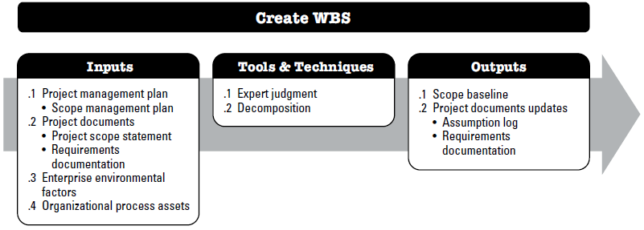
Create WBS
The process of subdividing project deliverables and project work into smaller, more manageable components.

Slide 45
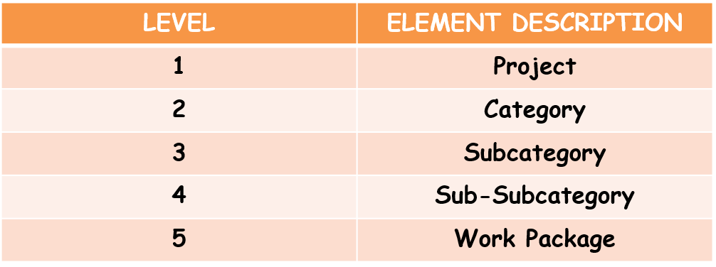
Work Breakdown Structure (WBS)
The WBS represents a logical decomposition of the work to be performed and focuses on how the product, service, or result is naturally subdivided. It is an outline of what work is to be performed.

Slide 46
Create WBS
Input:
PROJECT MANAGEMENT PLAN
A project management plan component includes but is not limited to the scope management plan.
PROJECT DOCUMENTS
Scope management plan.
EEF & OPA
EEF - industry-specific WBS standards
Requirement documentation
Stakeholder management plan
OPA - Policies, procedures, and templates for the WBS, Project files from previous projects, Lessons learned from previous projects.

Slide 47
Create WBS
Tools & Techniques:
    Expert Judgement
    Decomposition
Decomposition activities:
  Identifying and analyzing the deliverables and related work
  Structuring and organizing the WBS
  Decomposing the upper WBS levels into lower-level detailed components
  Developing and assigning identification codes to the WBS components
  Verifying that the degree of decomposition of the deliverables is appropriate.
Rolling wave planning and 100% rule applies in case of decomposition

Slide 48
Create WBS
Output:
Project Document Updates
Assumption log
Requirement documentation
acceptance criteria
Resource required, cost estimation,
Schedule milestones, associated activities
Responsible organization
Description of work
Code of account identifier
WBS Dictionary
Planning Package
Work Package
WBS
scope Statement
The scope baseline is the approved version of a scope statement, WBS, and its associated WBS dictionary, which can be changed only through formal change control procedures and is used as a basis for comparison
Project Scope Baseline

Slide 49
Create WBS
Output:
WBS Dictionary Element | Description
Code of Account Identifier | Unique alphanumeric code assigned to the work package for tracking and referencing.
Description of Work | Detailed explanation of the work scope, objectives, and deliverables for the WBS element.
Responsible Organization | Team, department, or individual accountable for performing the work.
Schedule Milestones & Activities | Key dates and checkpoints, including start/end dates and associated activities needed.
Resources Required & Cost Estimation | Types and quantities of resources (labor, materials, equipment) and estimated costs.
Acceptance Criteria | Standards or conditions that define when the work is considered complete and acceptable.

Slide 50
More on WBS
WBS is used for every project
WBS does not show the sequence of the execution. That will be determined when a schedule is developed.
The concept behind the WBS is very simple.
It requires you to break down complex tasks into smaller tasks until you reach a point where you can no longer subdivide the tasks.

Slide 51
More on WBS
Project
Task
Sub task
Sub task
Task
Sub task
Work package
Activity/Level of effort
Work Package
Work Package
Activity/Level of effort
Activity/Level of effort
Tasks should be broken down until you are able to:
  Manage the task
  Estimate the time required to complete the task
  Estimate the cost involved with the task
Rule 1 "80-hour rule" which means that no single activity or group of activities at the lowest level of detail of the WBS to produce a single deliverable should be more than 80 hours of effort.

Slide 52
More on WBS
Project
Task
Sub task
Sub task
Task
Sub task
Work package
Activity/Level of effort
Work Package
Work Package
Activity/Level of effort
Activity/Level of effort
Tasks should be broken down until you are able to:
  Manage the task
  Estimate the time required to complete the task
  Estimate the cost involved with the task
Rule 2 The second rule of thumb is that no activity or group of activities at the lowest level of detail of the WBS should be longer than a single reporting period. Thus, if the project team is reporting progress monthly, then no single activity or series of activities should be longer than one month long.

Slide 53
More on WBS
Example: Developing a Login Feature for a Mobile App
Step 1: Define the Deliverable
Deliverable: Login Feature Module
Backend Authentication (90 hours, 8 days) is too big according to Rule 1 and Rule 2.
Break it into smaller activities:
WBS Activity | Estimated Effort (Hours) | Duration (Days) | Notes
1. Design Login UI | 40 | 3 | Under 80 hours & within 1 reporting period (weekly report assumed)
2. Develop Frontend Logic | 70 | 5 | Under 80 hours & within 1 reporting period
3. Develop Backend Authentication | 90 | 8 | Break down required (exceeds 80 hours and 1 reporting period)
4. Integration Testing | 35 | 3 | Under 80 hours and 1 reporting period
5. Bug Fixing | 30 | 2 | Under 80 hours and 1 reporting period

Slide 54
More on WBS
Example: Developing a Login Feature for a Mobile App
Step 1: Define the Deliverable
Deliverable: Login Feature Module
Backend Authentication (90 hours, 8 days) is too big according to Rule 1 and Rule 2.
Break it into smaller activities:
Activity | Estimated Effort (Hours) | Duration (Days)
1. Design Login UI | 40 | 3
2. Develop Frontend Logic | 70 | 5
3.1 Setup Database Authentication | 40 | 3
3.2 Implement API Endpoints | 30 | 2
3.3 Security Testing & Validation | 20 | 2
4. Integration Testing | 35 | 3
5. Bug Fixing | 30 | 2

Slide 55
More on WBS
Example: Developing a Login Feature for a Mobile App
Step 1: Define the Deliverable
Deliverable: Login Feature Module
Backend Authentication (90 hours, 8 days) is too big according to Rule 1 and Rule 2.
Break it into smaller activities:
Sub-activity | Estimated Effort (Hours) | Duration (Days) | Notes
3.1 Setup Database Authentication | 40 | 3 | Meets both rules
3.2 Implement API Endpoints | 30 | 2 | Meets both rules
3.3 Security Testing & Validation | 20 | 2 | Meets both rules

Slide 56
More on Create WBS
WBS Development Guidelines:
  Stop breaking down work when you reach a low enough level to do an estimate of the desired accuracy
  Involve those people who must do the work in the planning process
  WBS should be completed before the schedule
  WBS does not have to be symmetrical
There are two types of WBS:
  Deliverable-Based
  Phase-Based.

Slide 57
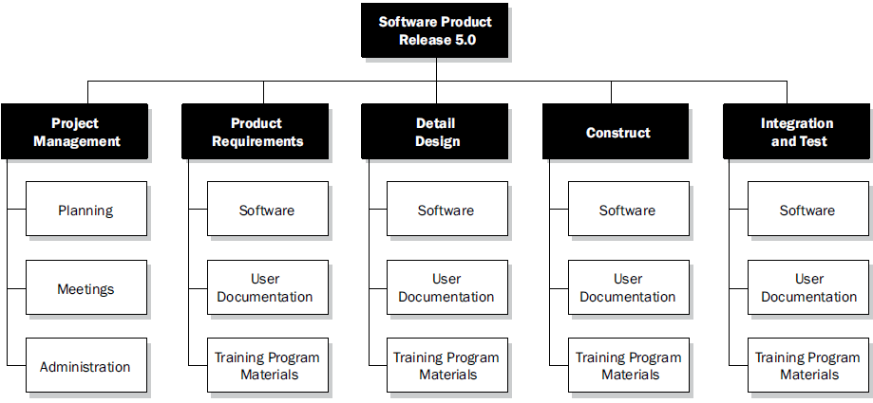
  Phase-Based

Slide 58
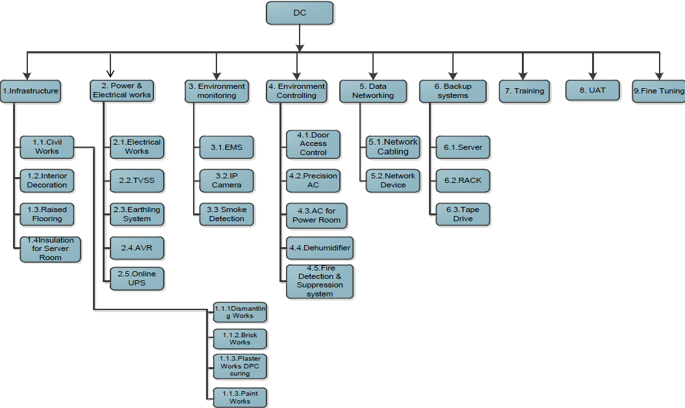
  Deliverable-Based

Slide 59
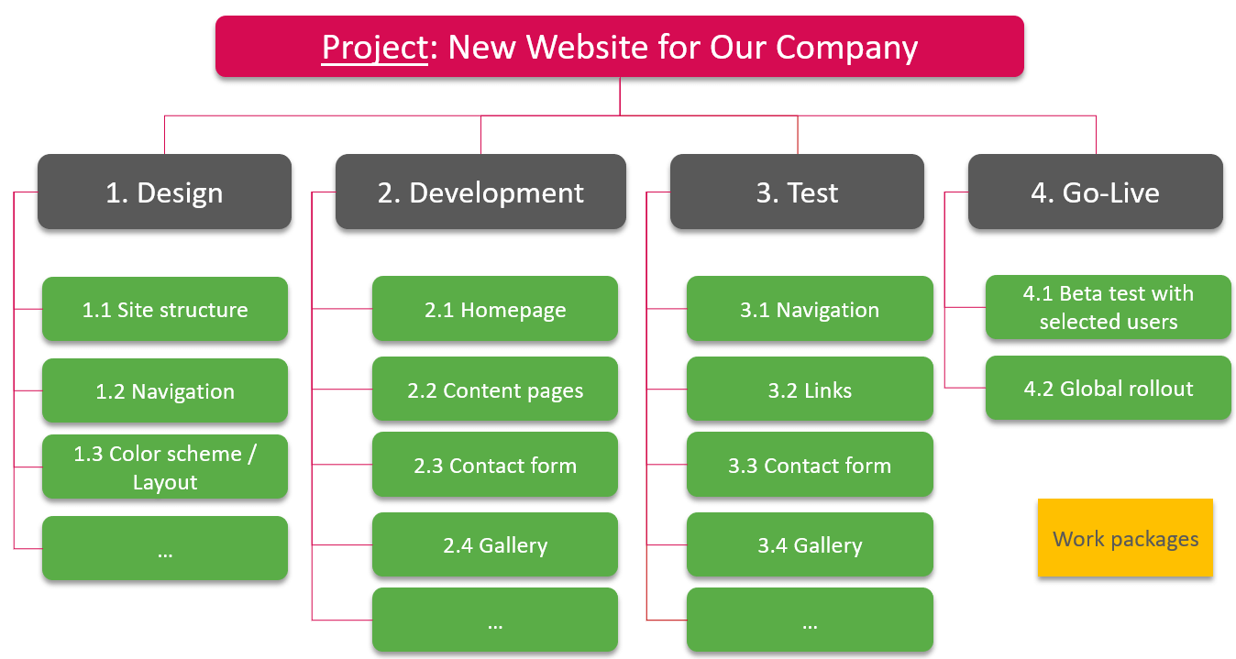

Slide 60
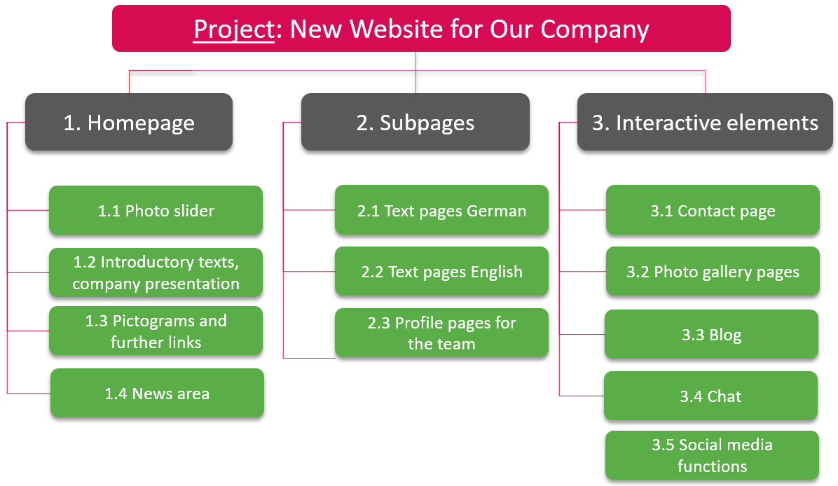

Slide 61
Plan Schedule Management
The process of establishing the policies, procedures, and documentation for planning, developing, managing, executing, and controlling the project schedule.
Process
Output
Plan Schedule Management
Schedule Management Plan

Slide 62
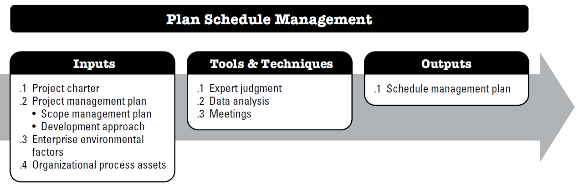
Plan Schedule Management
It provides guidance and direction on how the project schedule will be managed throughout the project

Slide 63
Plan Schedule Management
Input:
PROJECT CHARTER
defines the summary milestone schedule that will influence the management of the project schedule.
PROJECT MANAGEMENT PLAN
Scope management plan - how the scope will be defined and developed
EEF & OPA
EEF - Organizational culture and structure, physical resource availability, Scheduling software, Commercial databases, such as standardized estimating data
Development approach - help to define the scheduling approach, estimating techniques, scheduling tools, and techniques for controlling the schedule.
OPA - Historical information and lessons learned repositories, Existing formal and informal schedule development, management- and control-related policies, procedures, and guidelines, Templates and forms, Monitoring and reporting tools.

Slide 64
Plan Schedule Management
Tools & Techniques:
Expert judgment
Expertise should be considered from individuals or groups with specialized knowledge or training in previous, similar projects:
Data Analysis
Alternatives analysis can include determining which schedule methodology to use, or how to combine various methods on the project.
Meetings
may hold planning meetings to develop the schedule management plan.
Schedule development, management, and control;
Scheduling methodologies (e.g., predictive or adaptive life cycle);
Scheduling software; and
The specific industry for which the project is developed.

Slide 65
Plan Schedule Management
Output: Schedule management plan
Schedule Model: Scheduling methodologies and scheduling tools
Release and iteration length. When using an adaptive life cycle, the time-boxed periods for releases, waves, and iterations are specified.
Prescribed level of details necessary to manage the work
Level of accuracy acceptable range used to determine activity duration
Unit of measure: staff hour, meter, liters, tons, kilometers etc.
Control threshold: variance threshold
Rule of performance measurement: Earned value measurement technique (baseline, fixed formula) schedule performance measurement
Reporting formats: format and frequency
Process descriptions: schedule management processes are documented.

Slide 66
Define Activities
The process of identifying and documenting the specific actions to be performed to produce the project deliverables.
Process
Output
Define Activities
Activity List
Activity Attributes
Milestone List
Change Request
Project Management Plan Update

Slide 67
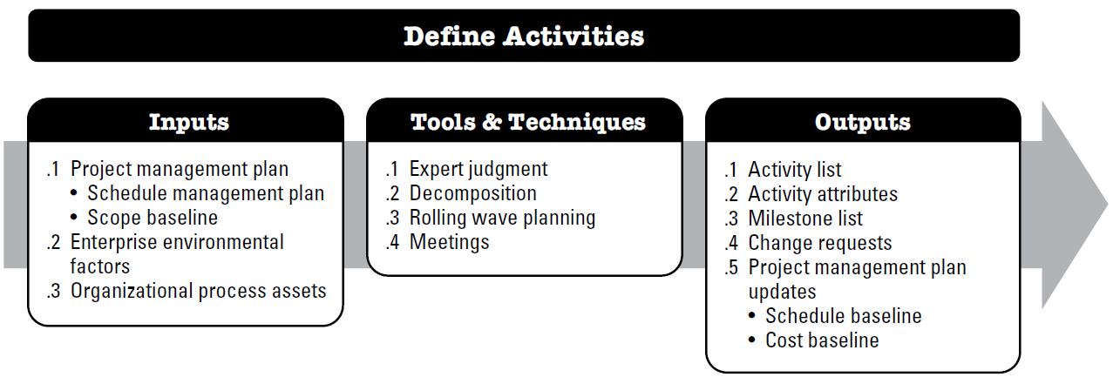
Define Activities
it decomposes work packages into schedule activities that provide a basis for estimating, scheduling, executing, monitoring, and controlling the project work.

Slide 68
Define Activities
Input:
PROJECT MANAGEMENT PLAN
Scope management plan - defines the schedule methodology, the duration of waves for rolling wave planning, and the level of detail necessary to manage the work
EEF & OPA
EEF - Organizational culture and structure, Project management information system (PMIS), Commercial databases
Scope baseline- The project WBS, deliverables, constraints, and assumptions documented in the scope baseline are considered explicitly while defining activities.
OPA - Historical information and lessons learned repositories, Standardized processes, Templates that contain a standard activity list, Existing formal and informal activity planning-related policies, procedures, and guidelines,

Slide 69
Define Activities
Tools & Techniques:
  Expert Judgement
  Decomposition
  Rolling Wave planning
  Meeting

Slide 70
Define Activities
Output:
Activity List
Comprehensive list including all schedule activities
Activity Attributes
the activity identifier, activity codes, activity description, predecessor activities, successor activities, logical relationships, leads and lags, resource requirements, imposed dates, constraints and assumptions
Milestone List
Identifies all the milestones and indicates whether the milestone is mandatory (required by the contract) or optional (based on project requirements)
Included activity identifies and scope of work description

Slide 71
Define Activities
Output:
Change Request
Once the project has been baselined, the progressive elaboration of deliverables into activities may reveal work that was not initially part of the project baselines.
Project Management Plan Update
Schedule baseline
Cost baseline

Slide 72
Sequence Activities
process of identifying and documenting relationships among the project activities.
it defines the logical sequence of work to obtain the greatest efficiency given all project constraints.
Process
Output
Sequence
Activities
Project Schedule Network Diagram
Project Documents update

Slide 73
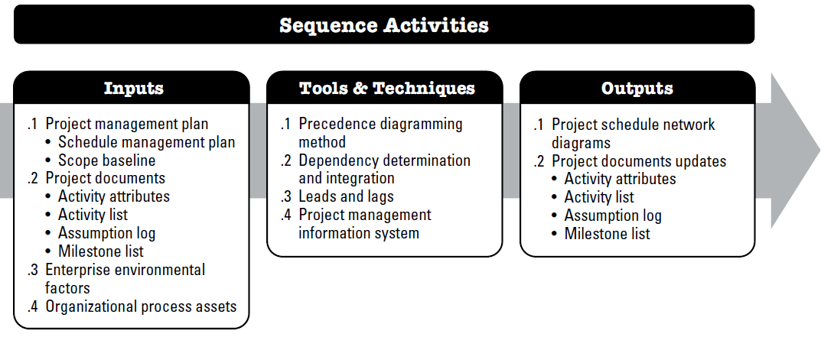
Sequence Activities
The Sequence Activities process concentrates on converting the project activities from a list to a diagram to act as a first step to publish the schedule baseline.

Slide 74
Sequence Activities
Input:
PROJECT MANAGEMENT PLAN
Schedule Management Plan
PROJECT DOCUMENTS
Activity List, Activity Attribute, Milestone list
EEF & OPA
EEF - Government or industry standards, Project management information system (PMIS), Scheduling tools, and Organization work authorization systems.
Assumption log
Scope Baseline
OPA - Standard, PMIS, tools, work authorization system, Scheduling methodology, LL knowledge base

Slide 75
Sequence Activities
Tools & Techniques:
  precedence diagramming method (PDM)
  Dependency Determination
  Leads and Lags
  Project management information system (PMIS)

Slide 76
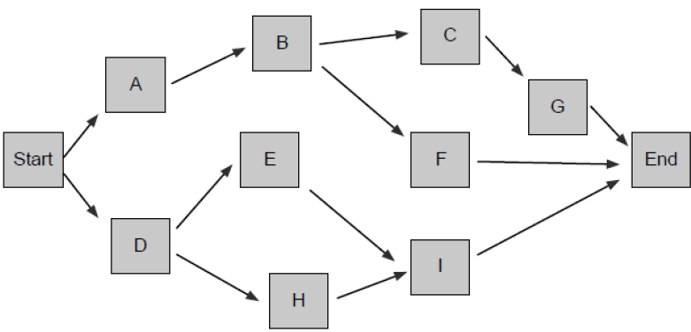
Sequence Activities
Tools & Techniques: precedence diagramming method (PDM)
  is a technique used for constructing a schedule model in which activities are represented by nodes and are graphically linked by one or more logical relationships to show the sequence in which the activities are to be performed.
Name | Predecessor
Start | -
A | Start
B | A
C | B
D | Start
E | D
F | B
G | C
H | D
I | E,H
End | F,G,I

Slide 77
Sequence Activities
Tools & Techniques: precedence diagramming method (PDM)
Types of Dependency
(based on logical relationship)
Finish to Start (F-S)
The initiation of the successor activity depends upon the completion of the predecessor activity
you cannot start testing a method before the test cases are developed
Start-to-start (S-S)
The initiation of the successor activity depends upon the initiation of the predecessor activity
Frontend coding can start only after UI design has started..
Finish-to-finish (F-F)
The completion of the successor activity depends upon the completion of the predecessor activity
The research report is finalized when data analysis is complete.
Start-to-finish (S-F)
The completion of the successor activity depends upon the initiation of the predecessor activity
Database Migration- to stop the old system you must start the new system

Slide 78


Sequence Activities
Tools & Techniques: precedence diagramming method (PDM)
Finish to Start (F-S)
Task B cannot start until task A finishes.
A – Write User Manual
B – Print User Manual
A
B

Slide 79


Sequence Activities
Tools & Techniques: precedence diagramming method (PDM)
Start to Start (S-S)
task B can only start when task A has started
A – Write Code for S/W Module X
B – Write DB Scripts for S/W Module X
A
B

Slide 80


Sequence Activities
Tools & Techniques: precedence diagramming method (PDM)
Finish to Finish (F-F)
task B cannot finish until task A finishes
A – Write Code for S/W Module X
B – Unit Test S/W Module X
A
B

Slide 81


Sequence Activities
Tools & Techniques: precedence diagramming method (PDM)
Start to Finish (S-F)
task B cannot finish until task A starts.
A – Start using New Software System
B – Phase out Old Software System
A
B

Slide 82
Sequence Activities
Tools & Techniques: precedence diagramming method (PDM)
FS is the most commonly used type of precedence relationship. The SF relationship is very rarely used
Two activities can have two logical relationships at the same time (for example, SS and FF).
Multiple relationships between the same activities are not recommended, so a decision has to be made to select the relationship with the highest impact.
Closed loops are also not recommended in logical relationships.

Slide 83
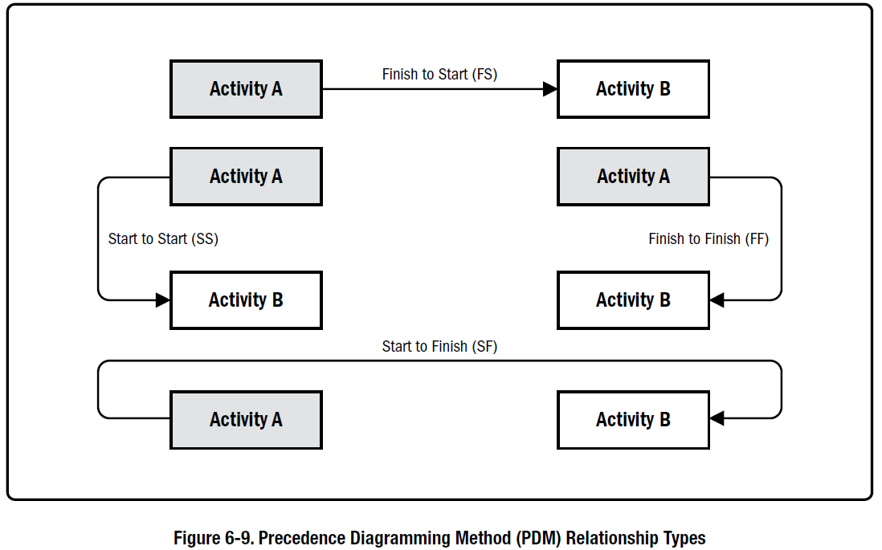
Sequence Activities
Tools & Techniques: precedence diagramming method (PDM)

Slide 84
Example of Precedence Diagramming Method
For one of your project followings are the task list:
technical design of module A (duration: 10 days),
technical design of module B (duration: 5 days),
development of module A (duration: 15 days),
development of module B (duration: 20 days), and
development of feature F in module B (duration: 1 day).
The technical dependencies are:
The technical design of module B cannot finish until the technical design of module A has been completed.
The technical designs of module A must be completed before the module A development can start.
The technical designs of module B must be completed before the module B development can start.
The development of module B can only be started when the development of module A has been started.
The development of feature F cannot be finished before the development of module B has started (although it can be developed independently, it needs to be integrated into module B)
Logical Relationship:
Activity (1) is predecessor of activity (2) in a finish-to-finish (FF) dependency (There could also be a start-to-start (SS) dependency between (1) and (2) but the FF relationship is prioritized as its impact is higher)
Activity (1) is predecessor of activity (3) in a finish-to-start (FS) relationship
Activity (2) is predecessor of activity (4) in a finish-to-start (FS) relationship
Activity (3) is predecessor of activity (4) in a start-to-start (SS) relationship
Activity (5) is a successor of activity (4) and in a start-to-finish (SF) relationship

Slide 85
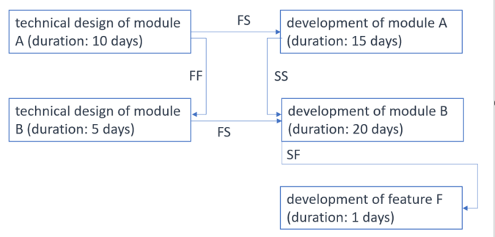
Example of Precedence Diagramming Method
Logical Relationship:
Activity (1) is predecessor of activity (2) in a finish-to-finish (FF) dependency (There could also be a start-to-start (SS) dependency between (1) and (2) but the FF relationship is prioritized as its impact is higher)
Activity (1) is predecessor of activity (3) in a finish-to-start (FS) relationship
Activity (2) is predecessor of activity (4) in a finish-to-start (FS) relationship
Activity (3) is predecessor of activity (4) in a start-to-start (SS) relationship
Activity (5) is a successor of activity (4) and in a start-to-finish (SF) relationship

Slide 86
Sequence Activities
Tools & Techniques: Dependency Determination
Types of dependency
(based on source of dependency)
Mandatory dependencies
Contractually required or inherent in the nature of the work (called hard logic)
You must design the database schema before coding queries..
Discretionary dependencies
defined by project management team. Known as “softlogic”, “preferential logic” or “preferred logic”
You prefer to finish UI before starting backend, even if both can go in parallel.
External dependencies
involve a relationship between project activities and non project activities.
Waiting for regulatory approval before launching a product.
Internal dependencies
Internal dependencies involve a precedence relationship between project activities and are generally inside the project team’s control.
The QA team can begin testing only after development is done.

Slide 87
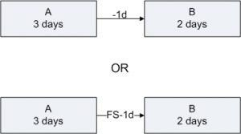
Sequence Activities
Tools & Techniques: Leads and Lags
The amount of time whereby a successor activity can be advanced with respect to a predecessor activity.
A Lead provides acceleration to the Successor Activity.
Consider two activities A and B.
  Duration of A – 3 days
  Duration of B – 2 days
  B has a Finish to Start Relationship with A with a Lead of 1 day.
  The scheduled start of B is 1 day before the scheduled Finish of A.
Project Team would need 4 days to complete these activities. If the said FS relationship was without any Lead, the Project Team would have needed 5 days.

Slide 88
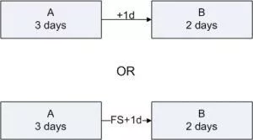
Sequence Activities
Tools & Techniques: Leads and Lags
The amount of time whereby a successor activity is required to be delayed with respect to a predecessor activity.
A Lag provides mandatory delay to the Successor Activity.
Consider two activities A and B.
  Duration of A – 3 days
  Duration of B – 2 days
  B has a Finish to Start Relationship with A with a Lag of 1 day.
  The scheduled start of B is 1 day after the scheduled Finish of A.
Project Team would need 6 days to complete these activities. If the said FS relationship was without any Lag, the Project Team would have needed 5 days.

Slide 89
Example of Leads and Lags
In a project, the durations are estimated as follows:
technical design of module A: 10 days
technical design of module B: 5 days
development of module A: 15 days
development of module B: 20 days
The dependencies are:
the technical designs of module A and B, respectively, must be completed before the respective module can be developed,
the technical design of module B makes reference to that of module A, thus, the module A design needs to be 50% completed before the module B design can be started, and
the development of module A depends on module B, which needs to be 25% completed before the team can start the development of module A.
Logical Relationship:
Activity 1 and activity 2 (SS with lag 5d)
Activity 1 and activity 3 (FS )
Activity 2and activity 4 (FS )
Activity 3 and activity 4 (SS with lag 5d )

Slide 90
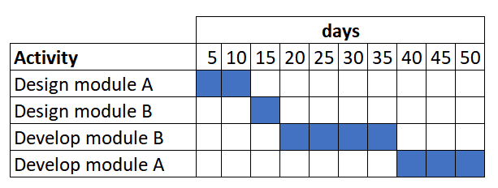
technical design of module A: 10 days
technical design of module B: 5 days
development of module A: 15 days
development of module B: 20 days
Schedule of the project based on just finish-to-start relationships.

Slide 91
Activity | Dependencies and durations | Lag time | Lead time
Design module A | takes 10 days | first activity | first activity
Design module B | can start 5 days after the design of module A started and takes 5 days | 5 days (after start of A) | 5 days (before finishing A)
Develop module B | can start when the design of module B is completed and takes 20 days | no lag | no lead
Develop module A | can start when module B is 25% completed and takes 15 days | 5 days (after start of B) | 15 days (before completion of B)
Design on A
Design of A
FS
Development of A
FS-15d
FS-5d
SS+5d
Development of B
Design of B
SS+5d
FS

Slide 92
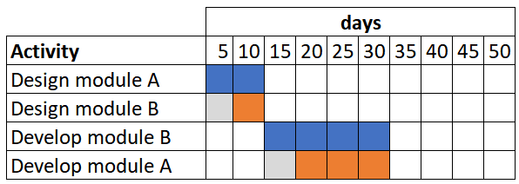
Activity | Dependencies and durations | Lag time | Lead time
Design module A | takes 10 days | first activity | first activity
Design module B | can start 5 days after the design of module A started and takes 5 days | 5 days (after start of A) | 5 days (before finishing A)
Develop module B | can start when the design of module B is completed and takes 20 days | no lag | no lead
Develop module A | can start when module B is 25% completed and takes 15 days | 5 days (after start of B) | 15 days (before completion of B)

Slide 93
Sequence Activities
Tools & Techniques: Project management information systems
is a software system or tool that helps plan, execute, monitor, and control all aspects of a project.
Function | Example
Planning | Create schedules, budgets, task lists
Resource management | Assign people, track availability
Communication | Share updates, send notifications
Documentation | Store project files, reports, meeting notes
Monitoring & control | Track progress, view earned value metrics, manage changes
Reporting | Generate dashboards and performance reports

Slide 94
Sequence Activities
Output:
Project schedule network diagram
Schematic displays of the project’s activities and their logical relationship
Project Document Update
Activity attributes
Activity list.
Assumption log.
Milestone list.

Slide 95
Estimate Activity Durations
is the process of estimating the number of work periods needed to complete individual activities with estimated resources.
The key benefit of this process is that it provides the amount of time each activity will take to complete.
Process
Output
Estimate Activity Durations
Activity Duration estimates
Project documents update

Slide 96
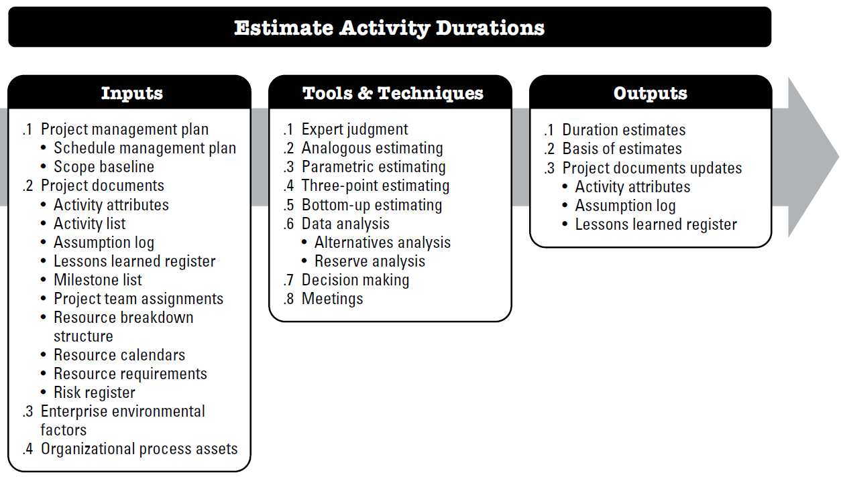
Estimate Activity Durations

Slide 97
Estimate Activity Durations
Input:
Project Mgt Plan
Schedule Management Plan
Project Documents
Activity attributes
EEF & OPA
EEF - Duration estimating databases and other reference data, Productivity metrics, Published commercial information, and Location of team members.
Schedule baselines
Activity list, Assumption log, Lessons learned register, Milestone list, Project team assignments, Resource breakdown Structure, Resource calendars, Resource requirements, Risk register
OPA - Historical duration information, Project calendars, Estimating policies, Scheduling methodology, and Lessons learned repository.

Slide 98
Estimate Activity Durations
Tools & Techniques:
Expert Judgment
Analogous Estimating
  Also called ‘Top-Down-Estimating’, means using the actual duration of a previous, similar activity as the basis for estimating the duration of a future activity.”
  Frequently used when limited amount of detailed information is available
  Less costly and time consuming
  More reliable when previous activities are similar in fact and circumstance and not only in appearance and when the individual preparing the estimate has the experience of similar activities
  Gross value estimation approach. Adjusted according to the difference
Parametric estimates
  Quantity of work multiplied by productivity rate can be used to estimate activity duration

Slide 99
Estimate Activity Durations
Tools & Techniques:
Three points estimates
  To improve the accuracy of estimates
    Optimistic (O) Estimate for all favorable conditions with no risks or changes
    Pessimistic (P) Estimate for all unfavorable conditions with all negative risks occurring and no mitigation
    Most likely (M) Estimate for both favorable and unfavorable conditions, with some risks occurring.
    Depending on the assumed distribution of values within the range of the three estimates, the expected duration, tE, can be calculated. One commonly used formula is triangular distribution:
    E = (O + M + P) / 3.
  Triangular distribution is used when there is insufficient historical data or when using judgmental data.

Slide 100
Estimate Activity Durations
Tools & Techniques:
Bottom-up estimating
  is a method of estimating project duration or cost by aggregating the estimates of the lower-level components of the WBS.
Data analysis
Decision-making
Meetings

Slide 101
Estimate Activity Durations
Output:
Duration Estimates
Duration estimates are quantitative assessments of the likely number of time periods that are required to complete an activity, a phase, or a project.
Basis of estimates
How it was developed
Project Documents Update
Activity Attributes
A range of 2 weeks ± 2 days, which indicates that the activity will take at least 8 days and not more than 12 (assuming a 5-day work week); or
A 15% probability of exceeding 3 weeks, which indicates a high probability—85%—that the activity will take 3 weeks or less.
Assumption & Constraints
Confidence level etc.
Assumption log
Lesson learned register

Slide 102
Develop Schedule
is the process of analyzing activity sequences, durations, resource requirements, and schedule constraints to create a schedule model for project execution and monitoring and controlling.
The key benefit of this process is that it generates a schedule model with planned dates for completing project activities..
Process
Output
Develop Schedule
Schedule baseline
Project schedule
Schedule data
Project calendar
Project management plan updates
Project documents update

Slide 103
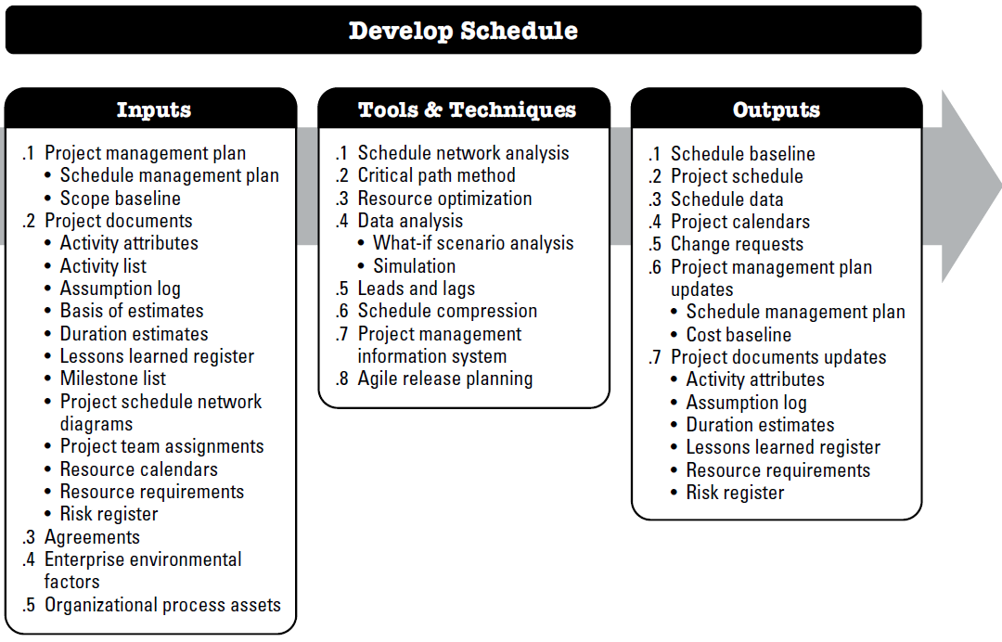
Develop Schedule

Slide 104
Develop Schedule
Input:
Project Mgt Plan
Schedule Management Plan
Project Documents
Activity attributes, Activity list, Assumption log, Basis of estimates, Duration estimates, Lessons learned register, Milestone list, Project schedule network diagrams, Project team assignments, Resource calendars, Resource requirements, Risk register
Agreements
Vendors may have an input to the project schedule as they develop the details of how they will perform the project work to meet contractual commitments.
Scope baselines
EEF &OPA
EEF - Government or industry standards, and Communication channels.
OPA - Scheduling methodology containing the policies governing schedule model development and maintenance, and Project calendar(s).

Slide 105
Develop Schedule
Tools & Techniques:
Schedule network analysis
  is the primary technique used to generate the project schedule model. It employs several other techniques such as critical path method, resource optimization techniques, and modeling techniques.
Critical Path Method
  A method used to estimate the minimum project duration
  Determine the schedule flexibility
  Calculates Early start, early finish, late start and late finish
  Performs forward and backward pass
  Disregards any resource limitation

Slide 106
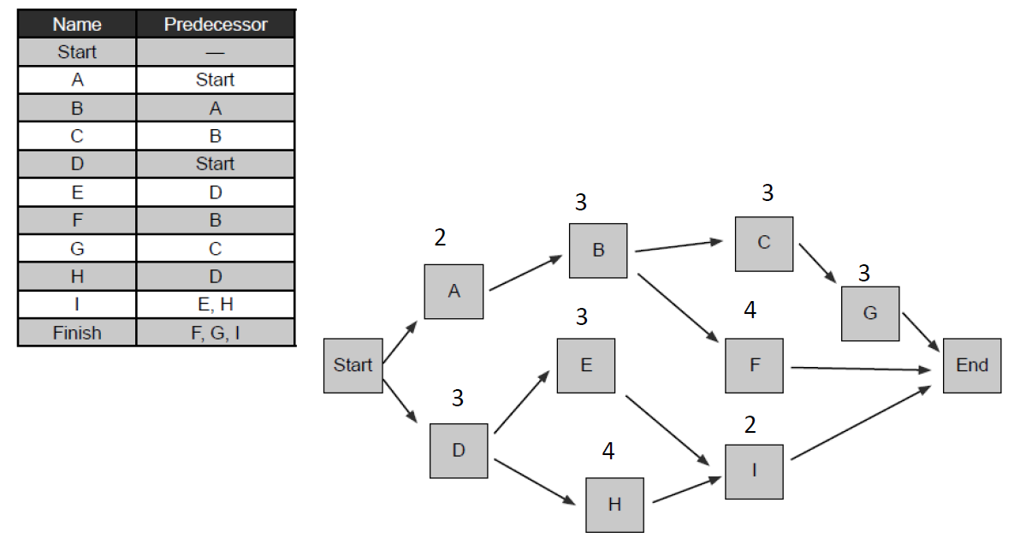
Develop Schedule
Tools & Techniques: Critical Path Method

Slide 107
Develop Schedule
Tools & Techniques: Critical Path Method
Abbreviations:
ES – Early Start
LS – Late Start
EF – Early Finish
LF – Late Finish
P – Predecessor
S – Successor
CP – Critical Path
D - Duration
Formulas:
0 Method
ESs= max (ESp+ Dp)
ES = EF of P
EF = ES + D
LFp = min(LFs - Dp)
LF = LS of S
LS = LF - D
1 Method
ES: EF of Pred+1
EF: (ES + Duration)-1
LF: LS of successor-1
LS: (LF-duration)+1
ES
Dur
EF
Activity Name
LS
Float/Slack
LF
The critical path is the sequence of activities with the longest duration.

Slide 108
Develop Schedule
Tools & Techniques: Critical Path Method
Concept | Formula | Interpretation
Free Float Determines how many days you can delay an activity without delaying the ES of the next activity. | Free Float = ES (S) – EF (P) | Number of days this activity can be delayed without delaying the ES of the next activity
Total Float Determines how many days you can delay an activity without delaying the project. | Total Float = LS – ES Total Float = LF – EF | Number of days this activity can be delayed without delaying the project.

Slide 109
Develop Schedule
Tools & Techniques: Critical Path Method
ES: EF of Pred+1
EF: (ES + Duration)-1
LF: LS of successor-1
LS: (LF-duration)+1
6
5
10
B
11
5
15
Start
1
5
5
16
15
30
A
End
D
1
0
5
16
0
30
6
10
15
C
6
0
15
ES
Dur
EF
Activity Name
LS
Float/Slack
LF

Slide 110
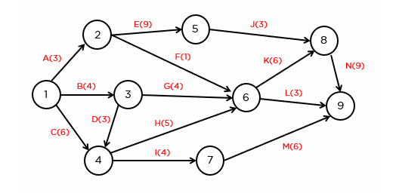
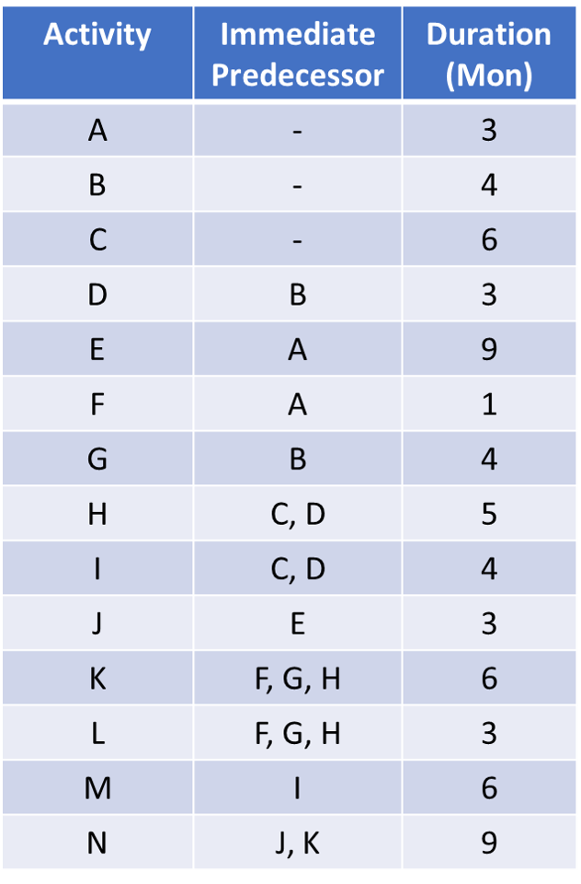
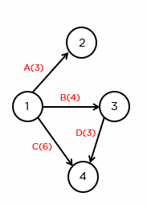
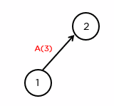
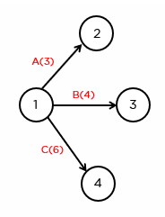
Develop Schedule
Tools & Techniques: Critical Path Method

Slide 111
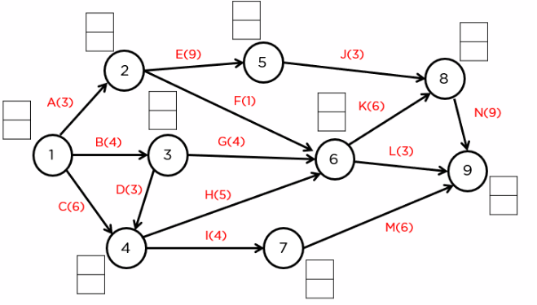
Develop Schedule
ESs= max (ESp+ Dp) LFp = min(LFs - Dp)
Tools & Techniques: Critical Path Method
12
3
15
6
18
18
4
12
ES
0
4
12
LF
0
27
27
7
11
7
21

Slide 112
Develop Schedule
ESp = LFs
ESs = LFs
ESs - ESp = LFs - LFp = Dps
12
3
15
6
18
18
4
12
ES
0
4
12
LF
0
27
27
7
11
7
21

Slide 113
Develop Schedule
ES: EF of Pred+1
EF: (ES + Duration)-1
LF: LS of successor-1
LS: (LF-duration)+1
Float = LF – EF
Tools & Techniques: Critical Path Method
3
3
5
6
8
13
B
C
1
2
6
3
8
9
3
16
2
14
7
20
A
G
4
3
5
17
3
23
Start
End
6
5
10
F
12
6
16
6
3
8
1
5
5
E
D
14
8
16
1
0
5
17
7
23
I
Start – A – B – C – G – End = 20
Start – A – B – F – G – End = 17
Start – D – E – I – End = 15
Start – D – H – I – End = 23
17
0
23
6
11
16
H
6
0
16

Slide 114
Develop Schedule
ESs= max (ESp+ Dp)
ES = EF of P
EF = ES + D
LFp = min(LFs - Dp)
LF = LS of S
LS = LF - D
Tools & Techniques: Critical Path Method
2
3
5
5
8
13
B
C
0
2
5
3
8
8
3
16
2
13
7
20
A
G
3
3
5
16
3
23
Start
End
5
5
10
F
11
6
16
5
3
8
0
5
5
E
D
13
8
16
0
0
5
16
7
23
I
Start – A – B – C – G – End = 20
Start – A – B – F – G – End = 17
Start – D – E – I – End = 15
Start – D – H – I – End = 23
16
0
23
5
11
16
H
5
0
16

Slide 115
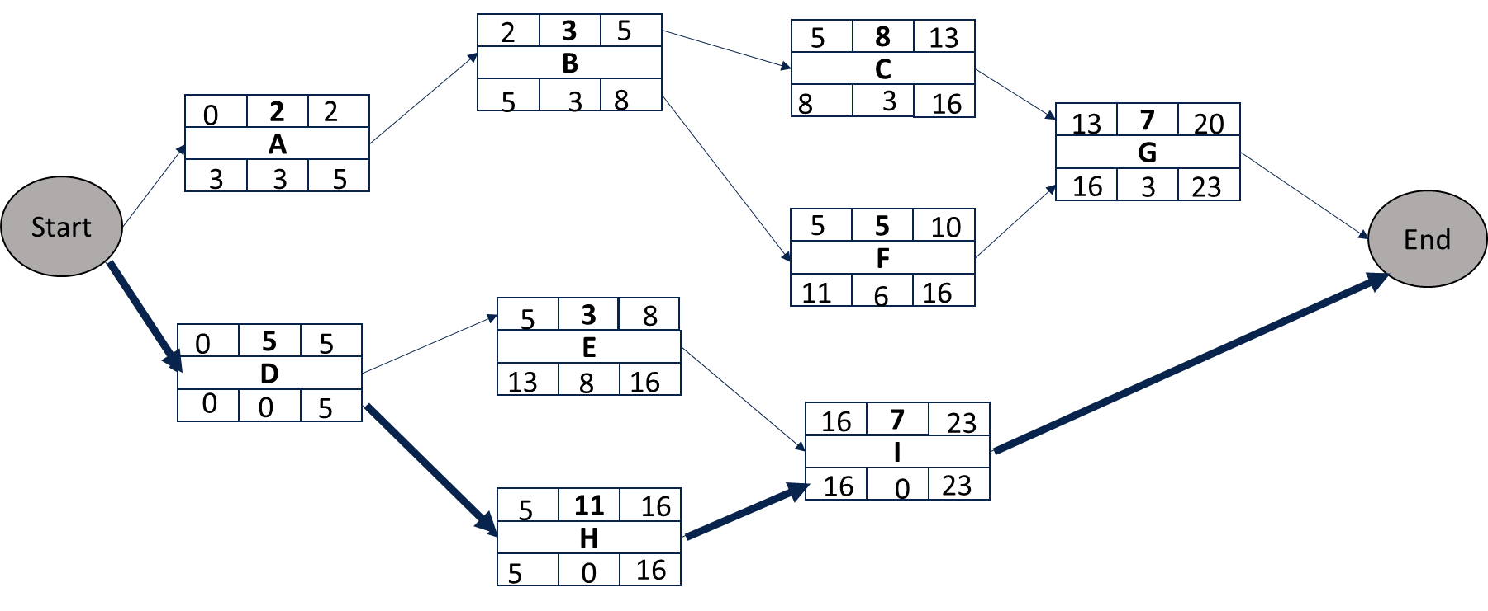

Differences:
First activity starts from “zero”
EF = ES + Duration
ES (Successor) = EF (Predecessor)
LF (Predecessor) = LS( Successor)
Differences:
First activity starts from “One”
EF = ES + Duration -1
ES (Successor) = EF (Predecessor) +1
LF (Predecessor) = LS( Successor) -1
Similarities:
Project duration
EF & LF of any activity
Float in any activity
Similarities:
Project duration
EF & LF of any activity
Float in any activity

Slide 116
Develop Schedule
Tools & Techniques: Critical Path Method
the minimum amount of time needed for a project to be completed.
the longest continuous path through a network diagram of interdependent tasks
delay in the tasks on the critical path will directly impact the overall project timeline.
Tasks on the critical path have zero slack or float, meaning there is no flexibility in their scheduling without affecting the project's completion date.
Identifying and managing the critical path is essential for project managers to ensure timely project delivery and efficient resource allocation.

Slide 117
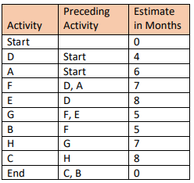
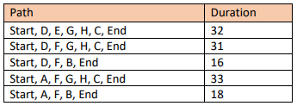
Develop Schedule
What is the duration of the critical path in months?
What is the float of activity B?
What is the float of activity E?
What is the float of activity D?

Slide 118
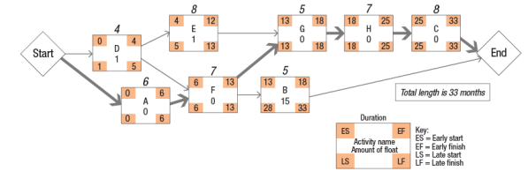
Develop Schedule
What is the duration of the critical path in months?
What is the float of activity B?
What is the float of activity E?
What is the float of activity D?

Slide 119
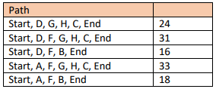
Develop Schedule
To shorten the length of the project, the sponsor has offered to remove the work of activity E from the project, making activity D the predecessor to activities G and F. What will be the effect?

Slide 120
Develop Schedule
Tools & Techniques: Resource Optimization
Resource Optimization is used to adjust the start and finish dates of activities to adjust planned resource use to be equal to or less than resource availability
• Resource leveling:
  A technique in which start, and finish dates are adjusted based on resource constraints to balance the demand for resources with the available supply.
  Resource leveling can often cause the original critical path to change. Available float is used for leveling resources. Consequently, the critical path through the project schedule may change.
• Resource smoothing:
  A technique that adjusts the activities of a schedule model such that the requirements for resources on the project do not exceed certain predefined resource limits.
  In resource smoothing, as opposed to resource leveling, the project’s critical path is not changed, and the completion date may not be delayed.
  In other words, activities may only be delayed within their free and total float. Resource smoothing may not be able to optimize all resources.

Slide 121
Resource Leveling
Day 1
Day 2
Day 3
Activity A
Bob 8 hrs | Tom 8 hrs
Start
Activity C
Tom 8 hrs
Activity C
Tom 8 hrs
Activity B
Bob 8 hrs
Start
Activity B
Bob 8 hrs
Activity A
Bob 8 hrs | Tom 8 hrs

Slide 122
Resource Smoothing
6
5
10
Design
11
5
16
16
15
30
ES
D
EF
Test
Analyze
16
0
30
LS
F
LF
6
5
15
Develop
6
0
15

Slide 123
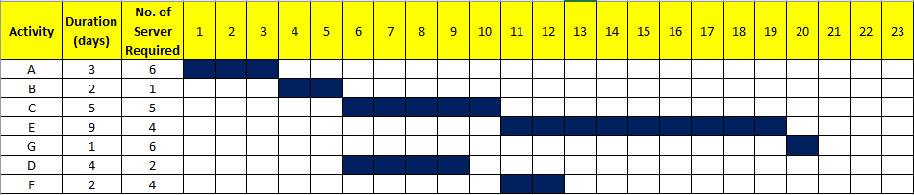
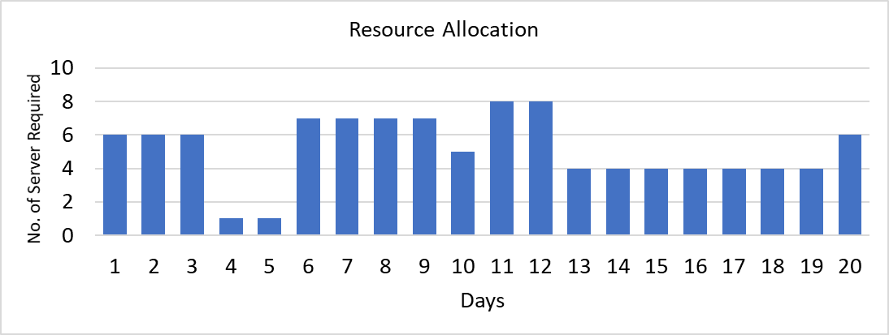
Develop Schedule
Tools & Techniques: Resource Optimization
Available No. of Server

Slide 124
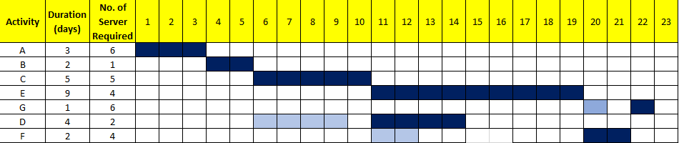
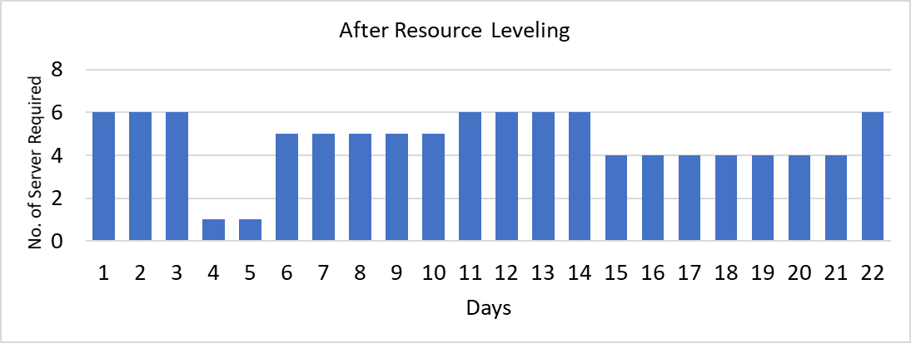
Develop Schedule
Tools & Techniques: Resource Optimization
Resource Leveling
The downside of resource leveling is that it might extend the overall project duration, as adjustments are made to avoid resource conflicts.
Resource leveling may impact the critical path of the project

Slide 125
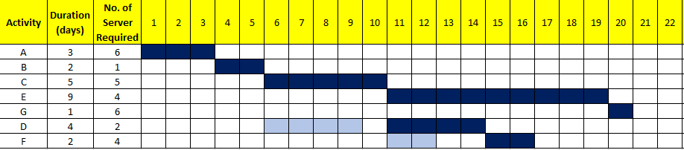
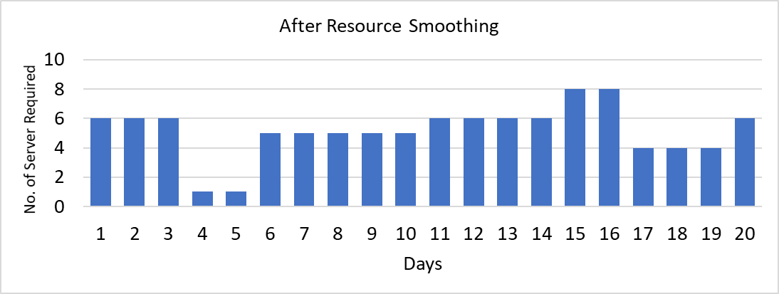
Develop Schedule
Tools & Techniques: Resource Optimization

Slide 126
Quiz Time (ungraded)
According to the draft project schedule, coding work on an IT project spanned for 2.5 months with a 0.5-month free float. The number of developers required for month 1, 2 and 3 were 8, 2, and 5 respectively. According to the budget, the project can afford a maximum of 6 developers in any month. Alice, the project manager, requested Bob, the Development Lead, to adjust the resource requirements for the coding activities to align with the available budget. Melissa rearranged the activities such that the developers required for month 1, 2 and 3 changed to 6, 4, and 5 respectively, and it resulted in extending the coding activity duration to 2.75 months.
This exercise of adjusting the schedule to meet the project constraints is an example of Smoothing

Slide 127
Develop Schedule
Tools & Techniques: Resource Optimization
Resource leveling is used when:
A critical resource may not be available for a certain duration;
A critical resource may not be available at a certain point of time;
You have to share a resource with another project;
The demand for a resource exceeds the supply.
Resource Smoothing is used when:
The end date is the main constraint of your project.

Slide 128
Develop Schedule
Tools & Techniques: Data Analysis
What-if scenario analysis
  What-if scenario analysis is the process of evaluating scenarios in order to predict their effect, positive or negative, on project objectives.
  This is an analysis of the question, “What if the situation represented by scenario X happens?”
  The outcome of the what-if scenario analysis can be used to assess the feasibility of the project schedule under different conditions, and in preparing schedule reserves and response plans to address the impact of unexpected situations.
Simulation
  Simulation models the combined effects of individual project risks and other sources of uncertainty to evaluate their potential impact on achieving project objectives.
  The most common simulation technique is Monte Carlo analysis, in which risks, and other sources of uncertainty are used to calculate possible schedule outcomes for the total project.

Slide 129
Develop Schedule
Tools & Techniques: Data Analysis
What-if scenario analysis
  What-if analysis is used to explore and compare various plan and schedule alternatives based on changing conditions..
  This is an analysis of the question, “What if the situation represented by scenario X happens?”
  The outcome of the what-if scenario analysis can be used to assess the feasibility of the project schedule under different conditions, and in preparing schedule reserves and response plans to address the impact of unexpected situations.
Some examples might be:
  What if lead time for major equipment or components is extended?
  What if we need to extend the duration of certain designing activities?
  What is the effect on completion date and resources if the current performance trend continues?
  What if you hire more people?
  What if your priorities change?

Slide 130
Develop Schedule
Tools & Techniques: Data Analysis
Simulation
  simulation is a powerful technique to assess schedule risk in project management.
  The most common simulation technique is Monte Carlo analysis.
  Monte Carlo simulation is a method of generating random samples from a specified distribution and using them to simulate the outcomes of a complex system or process.
  In project management, Monte Carlo simulation can be used to model the duration and cost of a project based on the estimates and assumptions of the project team.

Slide 131
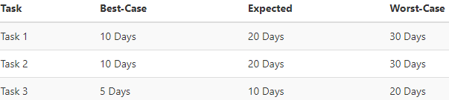
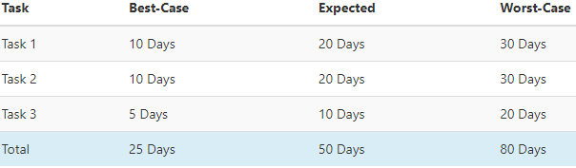
Develop Schedule
Tools & Techniques: Data Analysis
In a Monte Carlo analysis, we run the same model — selecting a random value for each task
We do it hundreds or thousands of times.
Each time it runs, we record the values.
Consider a simple project plan. This plan includes a single project, with three tasks:
Let's assume that, these tasks must be completed in sequence, meaning each task is dependent on the task before it. How long will the project take to complete?
This is useful, but still unrealistic; because it's unlikely that each task will take the best-case time, or the worst-case time. More likely, Some may take longer, while others finish ahead of schedule.

Slide 132
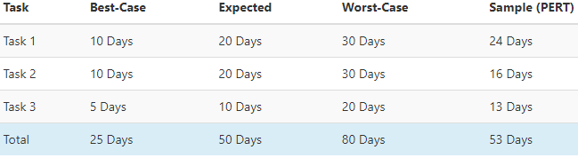
Develop Schedule
Tools & Techniques: Data Analysis
Now to add some randomness we will introduce PERT (Program Evaluation Review Technique)
PERT = (O + 4M +P) / 6
In this case, with random values selected for each task, you can see that the first task takes a little longer than expected. The last task takes longer as well. The second task is completed ahead of schedule.
However, A single random case is not useful, because it represents only one out of essentially limitless possibilities. This is where we can use Monte Carlo simulation to measure and understand the risk.

Slide 133
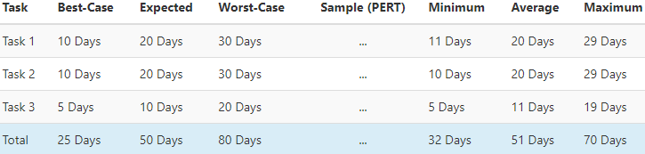
Develop Schedule
Tools & Techniques: Data Analysis
In a Monte Carlo analysis, we run the same model — selecting a random value for each task — but we do it hundreds or thousands of times.
Each time it runs, we record the values.
When the simulation is complete, we can look at statistics from the simulation' to understand the risk in the model.
We'll start with the basic statistics: the minimum, maximum, and average.
The first thing we can observe that the average completion time is close to our central estimate. That is what we would expect; it's the most likely case for each task. We can now say that the worst-case scenario is 70 days, instead of 80.
This data comes from a Monte Carlo analysis of 1,000 trials.
Next, we can look at the range of data generated during the Monte Carlo simulation to understand more about the projections.

Slide 134
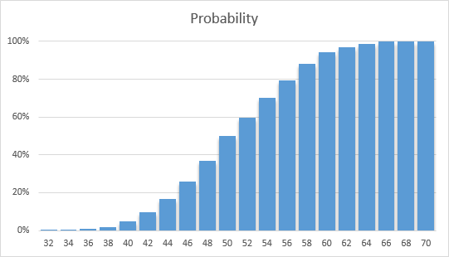
Develop Schedule
Tools & Techniques: Data Analysis
there is only a 5% chance that the project will be completed within 40 days
there is a 94% chance the project will be completed within 60 days.
What does it mean?
In only 5% of the trials (50 out of 1,000) the total project time was 40 days or less. We can therefore say that, during the simulation, there was a 5% probability that the project would be completed within 40 days.
Similarly, during the simulation, there was a 94% chance that the project was completed within 60 days.
Key Points
Estimated Range is 32-70 Days (Even though our best- and worst-case estimates result in totals of 25-80 days)
Probability of Completion within 50 Days is 50%
For 75% Confidence, Budget 55 Days; for 85% Confidence, Budget 58 Days
We can say that in 75% of the simulation trials, the project was completed within 55 days. We can budget for various confidence levels by looking at probability from the simulation.

Slide 135
Develop Schedule
Tools & Techniques:
Leads and lags
Project Management Information System (PMIS)
Agile Release Planning
  Agile release planning provides a high-level summary timeline of the release schedule (typically 3 to 6 months) based on the product roadmap and the product vision for the product’s evolution.
  also determines the number of iterations or sprints in the release and allows the product owner and team to decide how much needs to be developed and how long it will take to have a releasable product based on business goals, dependencies, and impediments

Slide 136

Develop Schedule
Relationship Between Product Vision, Release Planning, and Iteration Planning

Slide 137
Develop Schedule
Tools & Techniques: Schedule compression
Schedule compression techniques are :
  Crashing.
    With crashing, resources are added to the activities on the critical path, and the duration of the activities is reduced as a result.
  Fast tracking.
    A schedule compression technique in which activities or phases normally done in sequence are performed in parallel for at least a portion of their duration

Slide 138

Develop Schedule
Schedule Compression Comparison

Slide 139
Develop Schedule
Tools & Techniques: Schedule compression - Crashing
Time Is Money: Cost-Time Tradeoffs
  Reducing the time of a critical activity usually incurs additional direct costs.
Reasons for imposed project duration dates:
  Time-to-market pressures
  An unrealistic schedule
  Unforeseen delays
  Incentive contracts (bonuses for early completion)
  Imposed deadlines and contract commitments
  Overhead and public goodwill costs
  Pressure to move resources to other projects

Slide 140
Develop Schedule
Tools & Techniques: Schedule compression - Crashing
Determining Activities to Shorten
  Shorten the activities with the smallest increase in cost per unit of time.
  Assumptions:
    The cost relationship is linear.
    Normal time assumes low-cost, efficient methods to complete the activity.
    Crash time represents a limit—the greatest time reduction possible under realistic conditions.
    Slope represents a constant cost per unit of time.
    All accelerations must occur within the normal and crash times.

Slide 141

Develop Schedule
Tools & Techniques: Schedule compression - Crashing

Slide 142
Develop Schedule
Tools & Techniques: Schedule compression - Crashing
Based on the data provided in Table1, calculate the lowest cost of crashing to complete the project four weeks earlier than the baseline schedule. What activities should go through crashing for that?
Activity | Predecessor | Baseline |  | Crash
 |  | Time | Cost ($) | Time | Cost ($)
A |  | 10 | 4000 | 8 | 6000
B | A | 2 | 6000 | 2 | 6000
C | A | 14 | 22000 | 12 | 26000
D | A | 6 | 9000 | 5 | 10000
E | B,D | 9 | 14000 | 7 | 19000
F | C,E | 8 | 18000 | 4 | 36000

Slide 143

Develop Schedule
Tools & Techniques: Schedule compression - Crashing
Based on the data provided in Table1, calculate the lowest cost of crashing to complete the project four weeks earlier than the baseline schedule. What activities should go through crashing for that?
Identify the critical path in the baseline schedule (A-B-C-F).
Activity A: Baseline Time Savings = 10−8=2 weeks
Activity C: Baseline Time Savings = 14−12=2 weeks
Activity F: Baseline Time Savings = 8−4=4 weeks
Now, let's calculate the cost:
Total Cost of Crashing:
  Total Cost of Crashing=Sum of (Additional Crash Time Needed × Crash Cost Per Time Saved)
Activity A:
Crash Cost Per Time Saved = (6000−4000)/2=1000
Total Cost of Crashing for A = 2×1000=2000 dollars
Total Cost of Crashing for C = 2×2000=4000 dollars
Total Cost of Crashing for F = 4×4500=18000
Total Cost of Crashing = 2000 + 4000 = 6000

Slide 144
Develop Schedule
Output:
Schedule Baseline
Specific approved version of the project schedule model
Project Schedule
Bar chart
Schedule Data
Resource requirement by the time period,
Project calendars
Identifies working days and shifts
Time period in days or part in days is available or not available
Alternative schedule (best case, worst case),
Scheduling of contingency reserve
Milestone Chart
Project schedule network diagram
Can be changed through formal change control
Used as the basis for comparison

Slide 145
Develop Schedule
Output:
Change Requests
Modifications to the project scope or project schedule may result in change requests to the scope baseline, and/or other components of the project management plan.
Project management plan update
Schedule management plan
Project Document update
Activity attribute, Assumption log, Duration estimates, LL register, Resource requirement, Risk register
Cost baseline

Slide 146

Develop Schedule

Slide 147

Develop Schedule

